Slide 1


Filycia Renatha
30 May 2022

Slide 2

Outline
Executive Summary
Introduction
Methodology
Results
Conclusion
Appendix

Slide 3
Executive Summary
Summary of methodologies
Data Collection
With API
With Webscraping
Data Wrangling
Exploratory Data Analysis (EDA) with SQL
Exploratory Data Analysis (EDA) with data visualization using Pandas and Matplotlib
Building interactive visual with Folium
Building interactive dashboard with Plotly Dash
Predictive analysis using various Machine Learning classification method
Summary of all results
EDA results
Interactive analytics results
Predictive analysis results

Slide 4
Introduction
Project background and context
Space X advertises Falcon 9 rocket launches on its website with a cost of 62 million dollars; other providers cost upward of 165 million dollars each, much of the savings is because Space X can reuse the first stage. Therefore, if we can determine if the first stage will land, we can determine the cost of a launch. The goal of this project is to predict if the first stage of SpaceX Falcon 9 rocket will land successfully and where is it most likely to land successfully.
Problems you want to find answers
Ultimately is to predict if the first stage of SpaceX Falcon 9 rocket will land successfully, where we can also answer the following :
The relation of various features that determine the success rate of a successful landing.
What operating conditions needs to be in place to ensure a successful landing program.

Slide 5

Section 1

Slide 6
Methodology
Executive Summary
Data collection methodology:
SpaceX Rest API
Webscraping Falcon 9 and Falcon Heavy Launches Records from Wikipedia
Perform data wrangling
One-hot encoding was applied to categorical features
Perform exploratory data analysis (EDA) using visualization and SQL
Perform interactive visual analytics using Folium and Plotly Dash
Perform predictive analysis using classification models
Logistic Regression, K Nearest Neighbor, Support Vector Machine and Decision Tree models are built and evaluated based on their accuracy

Slide 7
Data Collection
Describe how data sets were collected.
Data collection was done using get request to the SpaceX API and web scrapping from Wikipedia.
Then the we parsed the response content from html using BeautifulSoup and from API .json() function call and turn it into a pandas dataframe using .json_normalize() function.
Next we cleaned the data by data wrangling including handling the missing values as necessary.
The final result is a pandas dataframe that can be exported into CSV for next step which is the Exploratory Data Analysis (EDA)
Data Collection process in a flowchart
SpaceX Rest API
Obtain response in JSON
Normalize data to create a panda dataframe
Export to CSV –
Ready for EDA
WebScrapping
Wikipedia
Parse response with BeautifulSoup
Create panda dataframe

Slide 8
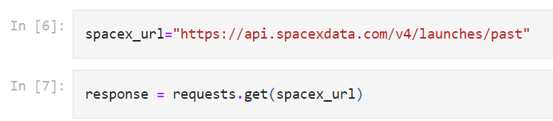
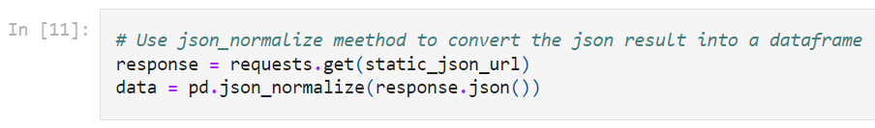
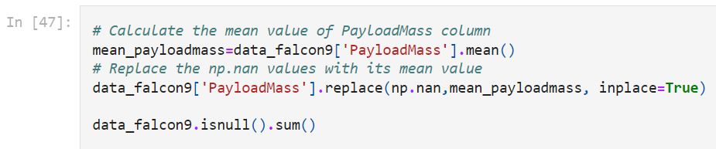
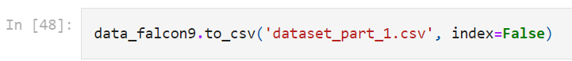
Data Collection – SpaceX API
Get request from API
Normalize the data
Deal with Missing values
Export to CSV
Present your data collection with SpaceX REST calls using key phrases and flowcharts
Add the GitHub URL of the completed SpaceX API calls notebook (must include completed code cell and outcome cell), as an external reference and peer-review purpose
SpaceX API : https://github.com/icharenatha/IBM_Data_Science_Capstone/blob/main/Data%20Collection%20API.ipynb

Slide 9
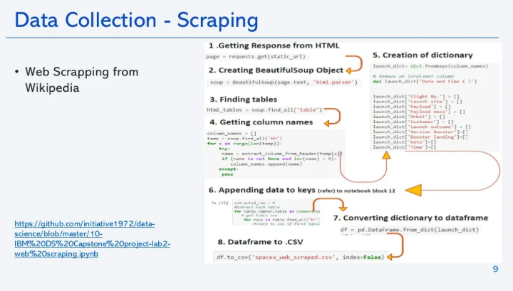
Data Collection - Scraping
Present your web scraping process using key phrases and flowcharts
Web Scrapping : https://github.com/icharenatha/IBM_Data_Science_Capstone/blob/main/Data%20Collection%20with%20Web%20Scraping.ipynb
Place your flowchart of web scraping here

Slide 10
Data Wrangling
Data wrangling process flowchart
Add the GitHub URL of your completed data wrangling https://github.com/icharenatha/IBM_Data_Science_Capstone/blob/main/Data%20Wrangling%20-%20EDA.ipynb
Loading the csv dataset from previous step
Identify numerical and categorical column
Calculate the number of launches on each launch site
Calculate number of occurrence of each orbit
Calculate the number and occurrence of mission outcome per orbit type
Create a landing outcome label from Outcome column
Assign the landing outcome label to the dataframe

Slide 11
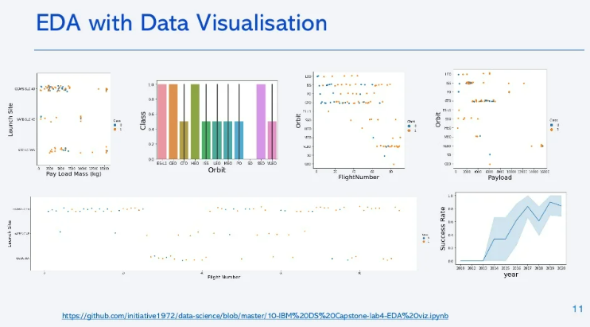
EDA with Data Visualization
Summarize what charts were plotted and why you used those charts
Add the GitHub URL of your completed EDA with data visualization notebook, as an external reference and peer-review purpose

Slide 12
EDA with SQL
The SQL queries performed are as follow
First we download the dataset (CSV format) and load the table into IBM DB2
In DB2, we change the data types and import the schema
Then we load the SQL table into Jupyter notebook using python magic %sql and connection strings
Then there are some EDA task we perform
Display the names of the unique launch sites in the space mission (select distinct)
Display 5 records where launch sites begin with the string 'CCA’ (…like ‘CCA%’ limit 5)
Display the total payload mass carried by boosters launched by NASA (CRS) (using group by and order by)
Display average payload mass carried by booster version F9 v1.1 (using avg in sub query, group by and order by)
List the date when the first successful landing outcome in ground pad was achieved. (using min DATE)
List the names of the boosters which have success in drone ship and have payload mass greater than 4000 but less than 6000
List the total number of successful and failure mission outcomes
List the names of the booster_versions which have carried the maximum payload mass using a subquery
List the failed landing_outcomes in drone ship, their booster versions, and launch site names for in year 2015
Rank the count of landing outcomes (such as Failure (drone ship) or Success (ground pad)) between the date 2010-06-04 and 2017-03-20, in descending order
Add the GitHub URL of your completed EDA with SQL notebook https://github.com/icharenatha/IBM_Data_Science_Capstone/blob/main/EDA%20with%20SQL.ipynb

Slide 13
Build an Interactive Map with Folium
Summarize what map objects such as markers, circles, lines, etc. you created and added to a folium map
First we marked all launch sites by adding markers, circles to easily find the launch site on the map
Then we add marker colors to differentiate success/failed launches on each site
We also create lines and distance marker to show distance of each launch sites to the nearest coastline, highway, railway and city.
Add the GitHub URL of your completed interactive map with Folium map, as an external reference and peer-review purpose https://github.com/icharenatha/IBM_Data_Science_Capstone/blob/main/lab_jupyter_launch_site_location.ipynb

Slide 14
Build a Dashboard with Plotly Dash
Summarize what plots/graphs and interactions you have added to a dashboard
Pie chart of Total Success launches of each sites
Dropdown interaction to pick each launch site and show it on the pie chart
Scatterplot to show the correlation between payload mass (kg) and launch outcome
Slider interaction to pick payload mass range and show it on the scatterplot
Add the GitHub URL of your completed Plotly Dash lab, as an external reference and peer-review purpose https://github.com/icharenatha/IBM_Data_Science_Capstone/blob/main/spacex_dash_app1.py

Slide 15
Predictive Analysis (Classification)
Summarize how you built, evaluated, improved, and found the best performing classification model
We loaded the data from CSV into panda dataframe
We choose feature X from the dataframe and standardized the data using .StandardScaler() function
We choose feature Y (Class / outcome) and create a numpy array
We split our data into training and test split. (train set 72 samples, test set 18 samples)
We built different machine learning models and tune different hyperparameters using GridSearchCV.
We get the accuracy of each model and found the best performing classification model.
Add the GitHub URL of your completed predictive analysis lab, as an external reference and peer-review purpose https://github.com/icharenatha/IBM_Data_Science_Capstone/blob/master/SpaceX_Machine%20Learning%20Prediction_Part_5.ipynb
Below is a permalink to the jupyter notebook just incase the file unable to be loaded correctly on GitHub using the above link
https://jp-tok.dataplatform.cloud.ibm.com/analytics/notebooks/v2/bec19779-a9fe-4dbd-95f8-08738062f346/view?access_token=bdb463948030ede1a5a4644f132a36c2a23e03021a623eb65b3923d103ae1e9e

Slide 16
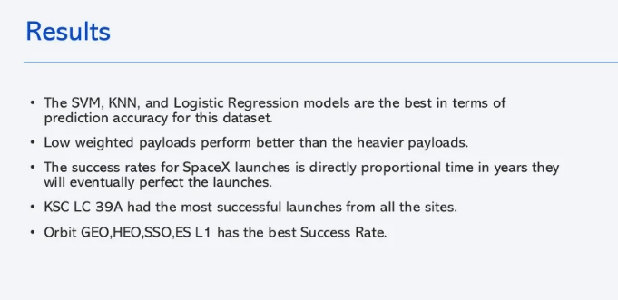
Results
Exploratory data analysis results
Interactive analytics demo in screenshots
Predictive analysis results

Slide 17

Section 2

Slide 18
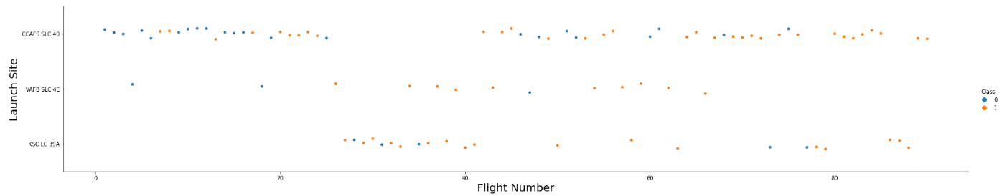
Flight Number vs. Launch Site
Show a scatter plot of Flight Number vs. Launch Site
Launches from CCAFS SLC 40 site is more frequent compare to the others.
KSC LC 39A site is only used after more than 20 flight number
As the flight number increase, the more successful first stage to land most likely from KSC LC 39A launch site.

Slide 19
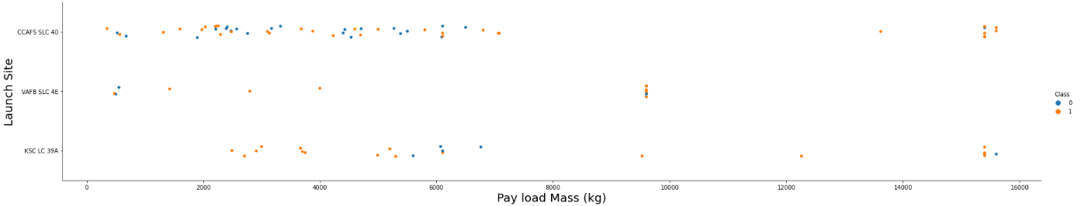
Payload vs. Launch Site
Show a scatter plot of Payload vs. Launch Site
VAFB-SLC launchsite there are no rockets launched for heavypayload mass(greater than 10000)
The majority of Pay Loads with lower mass (less than 10000) have been launched from CCAFS SLC 40

Slide 20
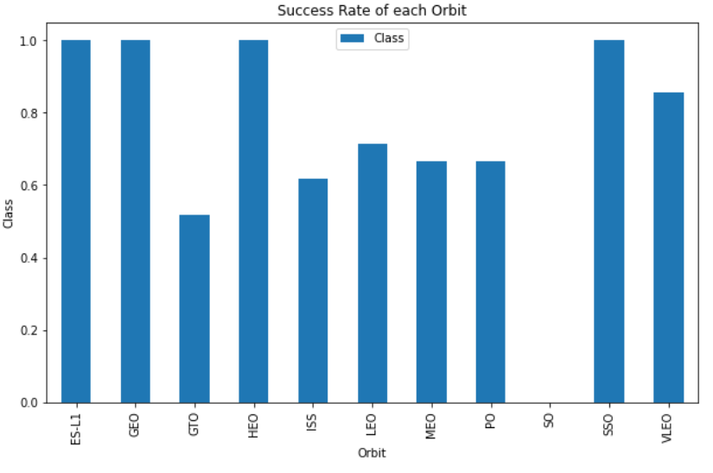
Success Rate vs. Orbit Type
Show a bar chart for the success rate of each orbit type
The highest success rate is on orbit ES-L1, GEO, HEO and SSO
The lowest success rate is on orbit GTO

Slide 21
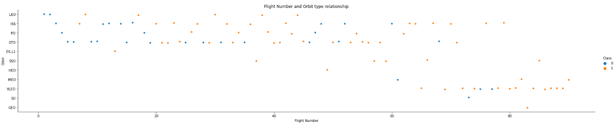
Flight Number vs. Orbit Type
Show a scatter point of Flight number vs. Orbit type
A shift to VLEO orbit is observed as the flight number increase
In the LEO orbit the success appears related to the number of flights; on the other hand, there seems to be no relationship between flight number when in GTO orbit

Slide 22
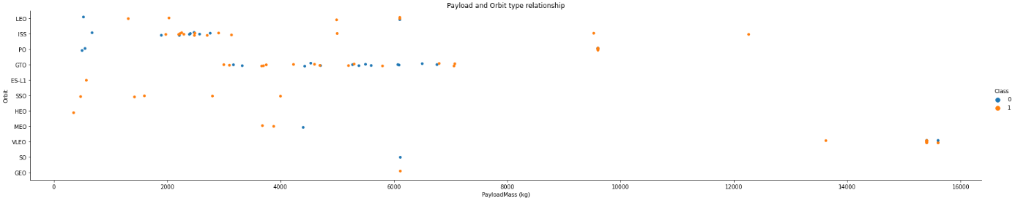
Payload vs. Orbit Type
Show a scatter point of Flight number vs. Orbit type
There are strong correlation between ISS orbit and Payload mass at the range around 2000, as well as between GTO at the range of 4000 – 8000
With heavy payloads the successful landing or positive landing rate are more for PO, LEO and ISS.
However for GTO we cannot distinguish this well as both positive landing rate and negative landing(unsuccessful mission) are both there here.

Slide 23
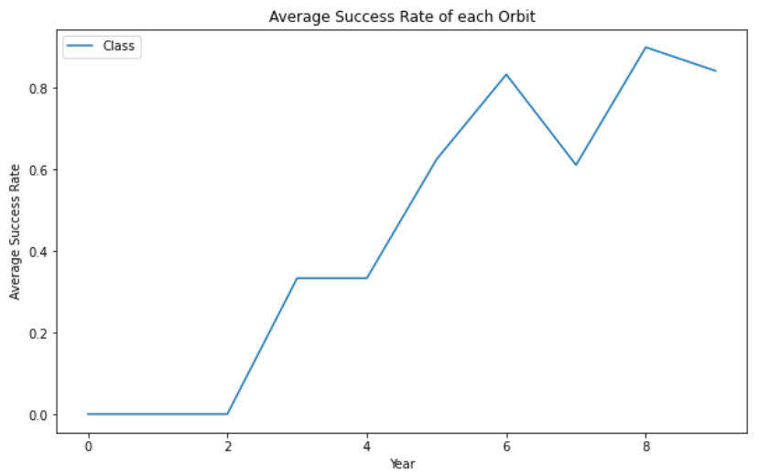
Launch Success Yearly Trend
Show a line chart of yearly average success rate
Launch success rate keep increasing since 2013 until 2020 and quite stabilized since 2019, potentially due to advance in research and technology

Slide 24
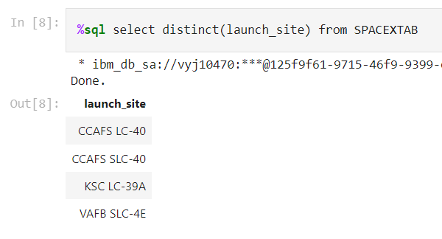
All Launch Site Names
Find the names of the unique launch sites
To do this, we use SQL magic in python with the following code

Slide 25
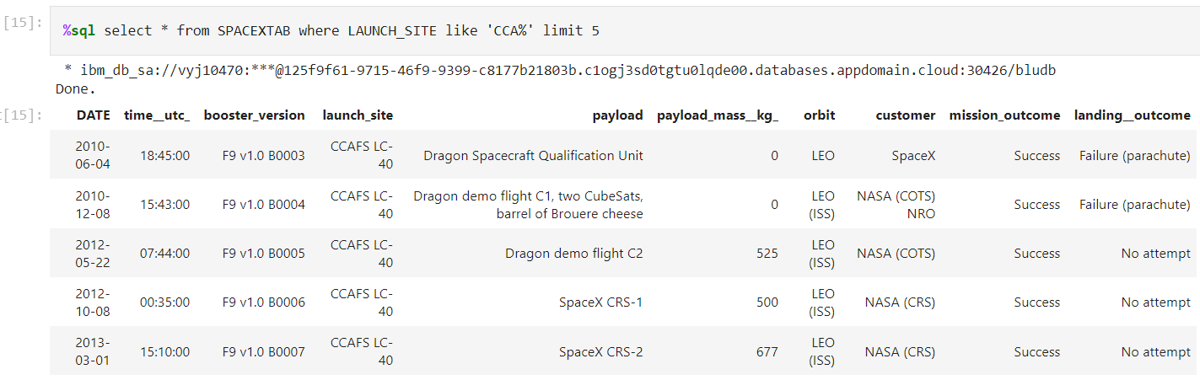
Launch Site Names Begin with 'CCA'
Find 5 records where launch sites begin with `CCA`

Slide 26
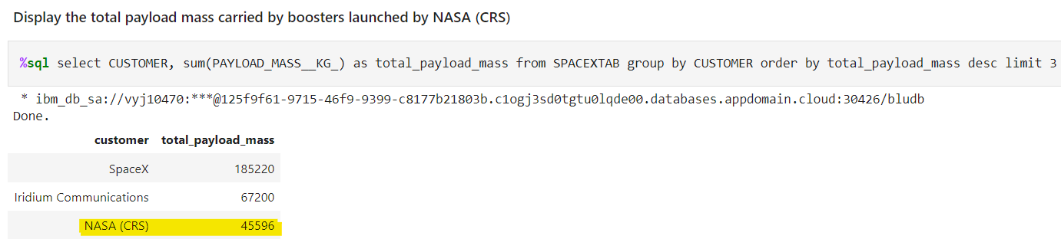
Total Payload Mass
Calculate the total payload carried by boosters from NASA (CRS)
The payload mass carried by bossters from NASA (CRS) is 45596
The following SQL code is actually to find the top 3 boosters customer where we can see that NASA (CRS) is on the top 3

Slide 27
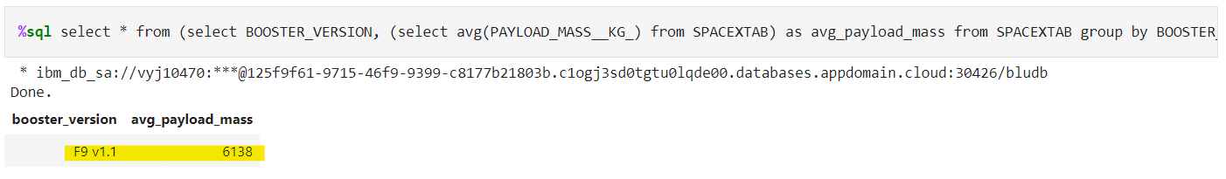
Average Payload Mass by F9 v1.1
Calculate the average payload mass carried by booster version F9 v1.1
We are using avg function in a subquery to find the average payload mass carried by booster version F9 v1.1

Slide 28
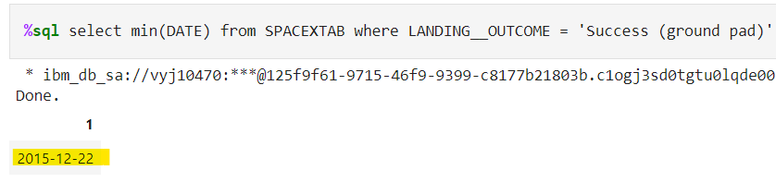
First Successful Ground Landing Date
Find the dates of the first successful landing outcome on ground pad
Here we are using min() function

Slide 29
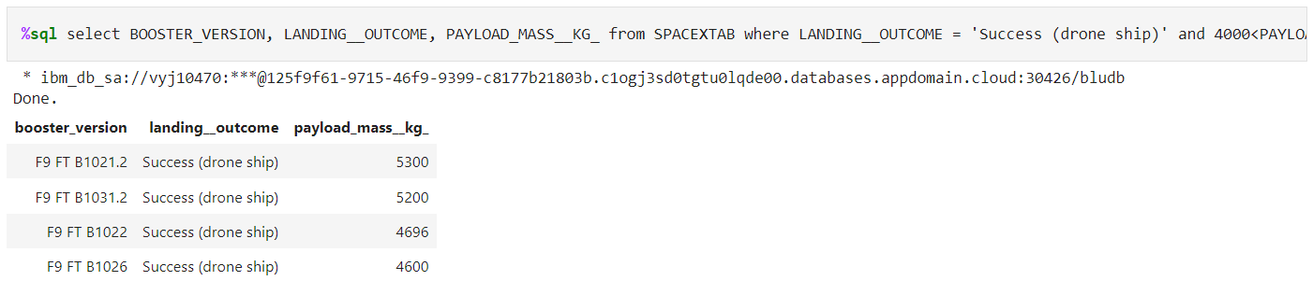
Successful Drone Ship Landing with Payload between 4000 and 6000
List the names of boosters which have successfully landed on drone ship and had payload mass greater than 4000 but less than 6000
%sql select BOOSTER_VERSION, LANDING__OUTCOME, PAYLOAD_MASS__KG_ from SPACEXTAB where LANDING__OUTCOME = 'Success (drone ship)' and 4000< PAYLOAD_MASS__KG_<6000

Slide 30
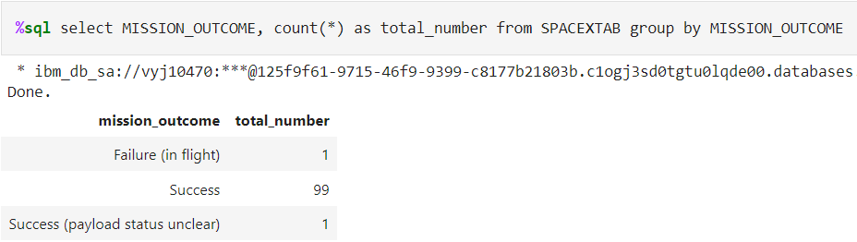
Total Number of Successful and Failure Mission Outcomes
Calculate the total number of successful and failure mission outcomes
Mission outcomes total number is 1 failure and 100 success, however 1 have payload status unclear

Slide 31
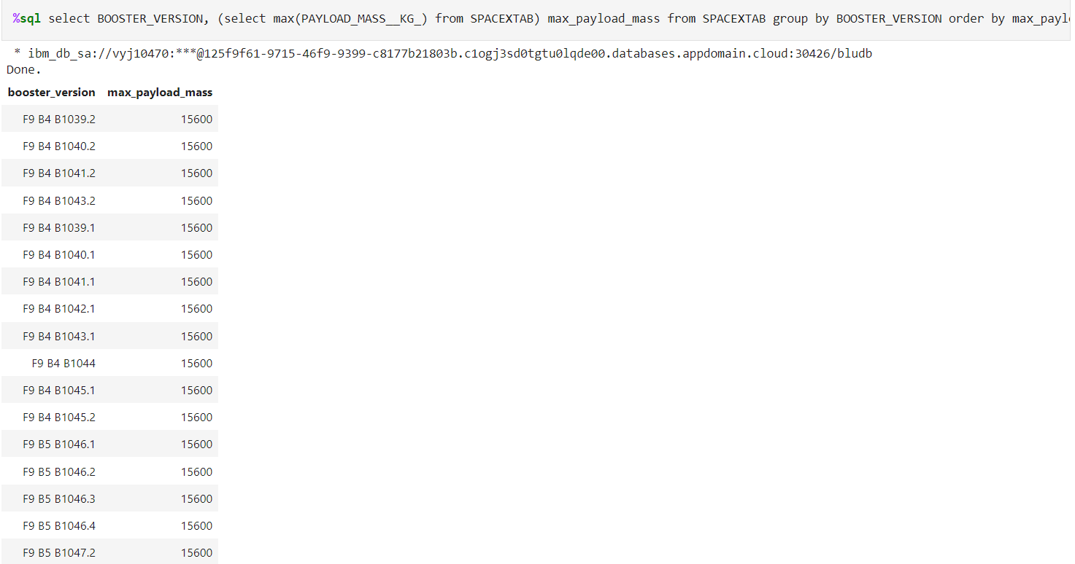
Boosters Carried Maximum Payload
List the names of the booster which have carried the maximum payload mass
Here we are using max() function

Slide 32
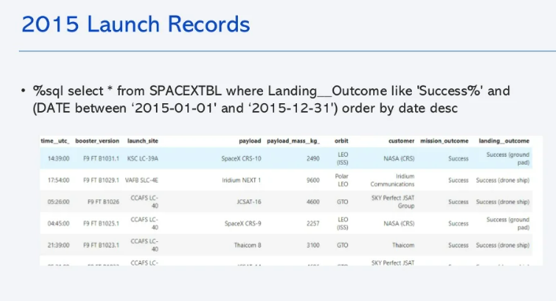
2015 Launch Records
List the failed landing_outcomes in drone ship, their booster versions, and launch site names for in year 2015
Present your query result with a short explanation here

Slide 33
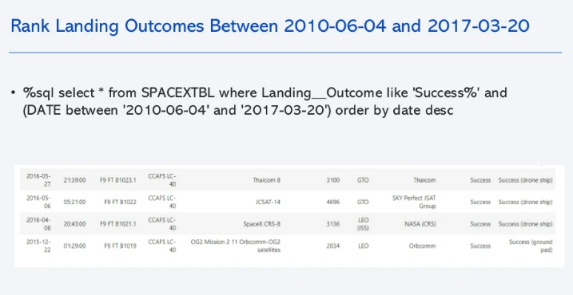
Rank Landing Outcomes Between 2010-06-04 and 2017-03-20
Rank the count of landing outcomes (such as Failure (drone ship) or Success (ground pad)) between the date 2010-06-04 and 2017-03-20, in descending order
Present your query result with a short explanation here

Slide 34

Section 3

Slide 35
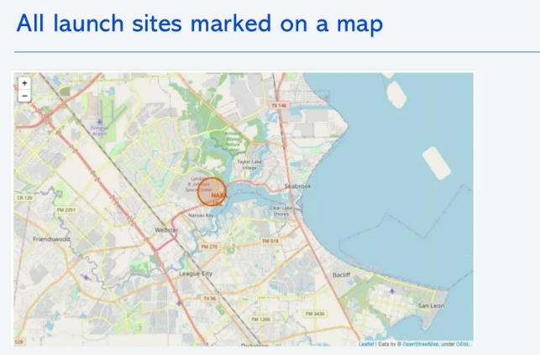
Lanch Sites marked on a map
Replace <Folium map screenshot 1> title with an appropriate title
Explore the generated folium map and make a proper screenshot to include all launch sites’ location markers on a global map
Explain the important elements and findings on the screenshot

Slide 36
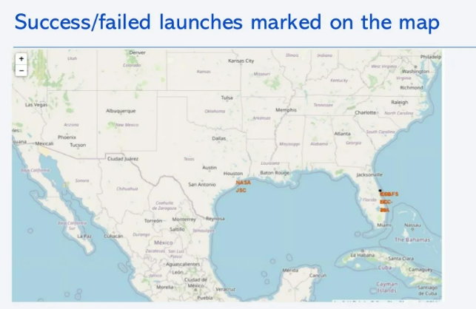
<Folium Map Screenshot 2>
Replace <Folium map screenshot 2> title with an appropriate title
Explore the folium map and make a proper screenshot to show the color-labeled launch outcomes on the map
Explain the important elements and findings on the screenshot

Slide 37
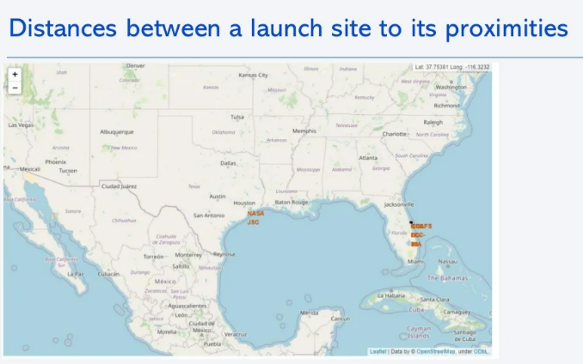
<Folium Map Screenshot 3>
Replace <Folium map screenshot 3> title with an appropriate title
Explore the generated folium map and show the screenshot of a selected launch site to its proximities such as railway, highway, coastline, with distance calculated and displayed
Explain the important elements and findings on the screenshot

Slide 38

Section 4

Slide 39
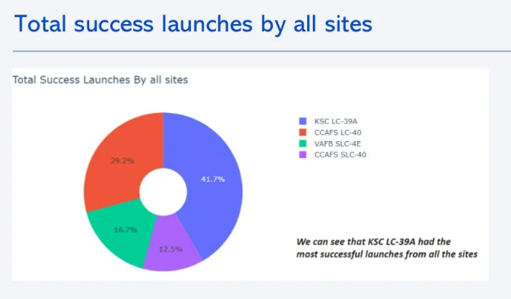
<Dashboard Screenshot 1>
Replace <Dashboard screenshot 1> title with an appropriate title
Show the screenshot of launch success count for all sites, in a piechart
Explain the important elements and findings on the screenshot

Slide 40
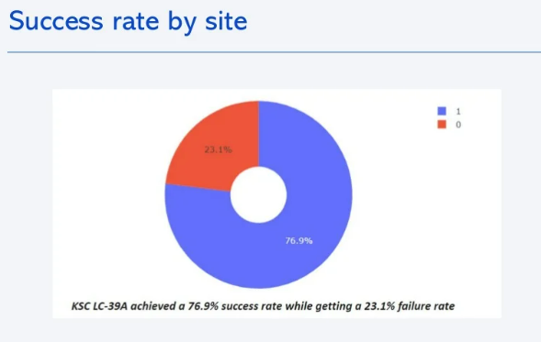
<Dashboard Screenshot 2>
Replace <Dashboard screenshot 2> title with an appropriate title
Show the screenshot of the piechart for the launch site with highest launch success ratio
Explain the important elements and findings on the screenshot

Slide 41
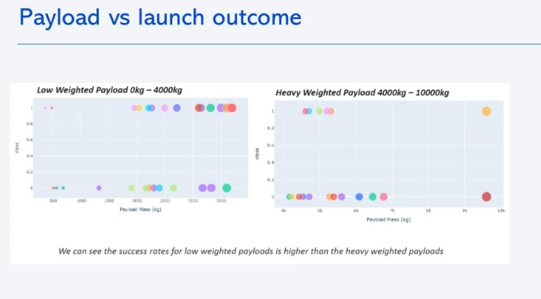
<Dashboard Screenshot 3>
Replace <Dashboard screenshot 3> title with an appropriate title
Show screenshots of Payload vs. Launch Outcome scatter plot for all sites, with different payload selected in the range slider
Explain the important elements and findings on the screenshot, such as which payload range or booster version have the largest success rate, etc.

Slide 42

Section 5

Slide 43
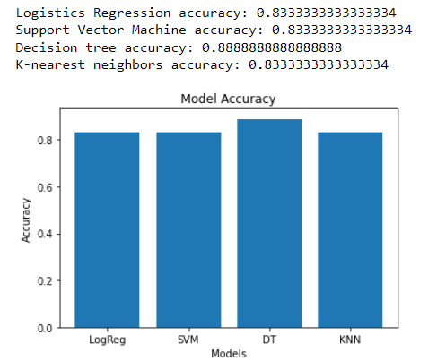
Classification Accuracy
Visualize the built model accuracy for all built classification models, in a bar chart
Find which model has the highest classification accuracy
All models have similar accuracy score, however the highest is Decision Tree for 0,88

Slide 44
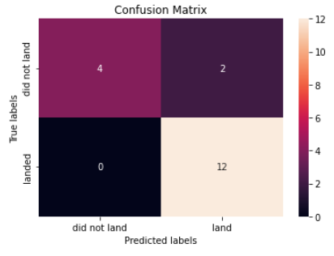
Confusion Matrix
Show the confusion matrix of the best performing model with an explanation
The best performing model is Decision tree and this is the confusion matrix
Based on the prediction, 12 test samples will land successfully and 4 wil not land successfully
This model has 2 false positive and 0 false negative

Slide 45
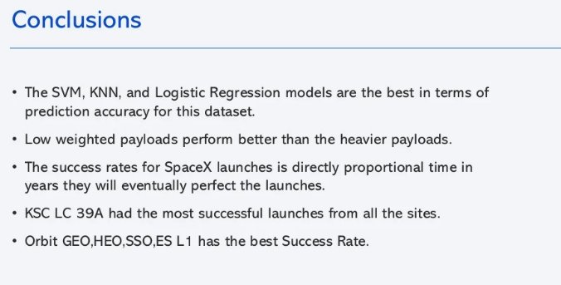
Conclusions
The best model to predict if first stage will successfully land or not is Decision Tree
The larger the flight amount at a launch site, the greater the success rate at a launch site.
Launch success rate started to increase in 2013 till 2020.
Orbits ES-L1, GEO, HEO, SSO, VLEO had the most success rate.
KSC LC-39A had the most successful launches from all sites.
The Decision tree classifier is the best machine learning algorithm for this task.

Slide 46
Appendix
Include any relevant assets like Python code snippets, SQL queries, charts, Notebook outputs, or data sets that you may have created during this project

Slide 47


